Slide 1

SOCIAL STRATIFICATION
PRESENTED BY
AMBREEN ( 21L-6296 )
ANWAAR ( 21L-5667 )
TAIMOOR ( 21L-6268 )
ROOHAN ( 21L-5629 )

Slide 2

What is Social Stratification?
Social stratification is the division of society into categories, ranks, or classes.
These divisions lead to social inequality - the unequal sharing of resources and social rewards.
Stratification systems lie on a continuum of open to closed systems according to how easy or difficult it is to change statuses.
Both ascribed and achieved statuses can be used to determine social standing.

Slide 3

Characteristics of social stratification
Hierarchical Structure: Society's layers with varying access to resources.
Inequality: Unequal distribution of resources, privileges, and opportunities.
Social Mobility: Ability for individuals to move between strata.
Perpetuation: Stratification tends to persist across generations.
Social Institutions: Linked with economy, education, politics, etc.
Legitimization: Justified through ideologies attributing differences to merit.
Intersectionality: Influence of multiple factors like race, gender, etc.
Global Dimension: Exists on a global scale, affecting nations and regions.

Slide 4
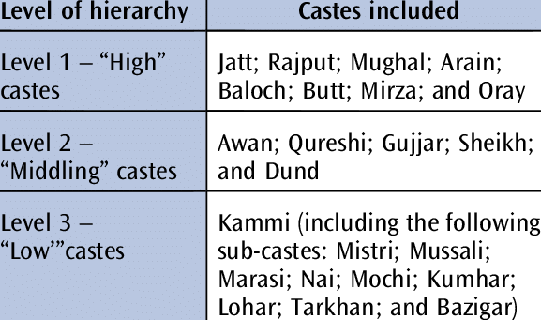
TYPES OF STRATIFICATION SYSTEM
CASTE SYSTEMS
Closed stratification system.
Life long status determined by that of parents.
People judge on the basis of caste.
Prohibits exogamy, or marriage outside of caste; promotes endogamy, or marriage within caste.

Slide 5
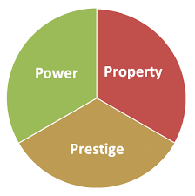

TYPES OF STRATIFICATION SYSTEM CTND.
CLASS SYSTEM
In a class system, it’s more possible for people to move between social levels
.Resources and rewards are given based on what someone has accomplished
.People have some say in where they fit in society.
Karl Marx talked about two main groups in society:
Those who own things that make stuff (like factories)
Workers who trade their work for money.

Slide 6
EXPLAINING STRATIFICATION
Functionalist Theory:
It says that having different levels in society is needed. Some jobs have to be done to keep things stable.
Conflict Theory:
This theory says that competition over limited stuff leads to different levels. The rich and powerful exploit the poor.
Trying to Combine Ideas:
Dahrendorf says that maybe both ideas have some truth. Each might explain different parts of why society has different levels.

Slide 7
What determines Social class?
Karl Marx
Class is based on the ownership of the factors of production.
Owners in a capitalist society
Self labor for wages
Believed that the government represents the interests of the ruling class and serves to oppress the working class.
MAX WEBER
Class is based on three factors:
WEALTH ( PROPERTY )
POWER
PRESTIGE
Believed that the government can play a more neutral role , but can also be influenced by powerful individuals or groups.

Slide 8
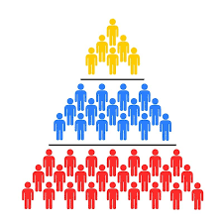
SOCIAL MOBILITY
Social mobility is the movement between or within social classes.
Horizontal mobility refers to movement within a social class or stratum.
Vertical mobility refers to the movement between social classes or strata.
There are two kinds of vertical mobility:
intragenerational mobility (within a person's lifetime)
intergenerational mobility (several generations of one family)

Slide 9
Causes of Social Mobility
Causes of Upper mobility
Individual Effort
Technological change
Change in merchandising patterns
Increase in population’s general educational level
Causes of downward mobility
Personal Factors such as illness , divorce , or retirement
Technological change altering the demand for labor
Overall economic health

Slide 10
Social Inequality and Poverty
Understanding the Multidimensional Nature of Social Inequality
Social inequality extends far beyond just differences in income and wealth. It encompasses disparities in access to education, healthcare, housing, employment opportunities, and social mobility. These inequalities often intersect and reinforce one another, creating complex and persistent barriers for those on the lower rungs of the socioeconomic ladder.
The Cycle of Poverty
Poverty is not just a lack of financial resources, but a multifaceted predicament that traps individuals and communities in a self-perpetuating cycle. Limited access to quality education, job opportunities, and healthcare exacerbates poverty, making it increasingly difficult for those born into disadvantaged circumstances to break free and achieve upward mobility.

Slide 11

Role of education in social stratification
Reproduction of Inequality: Education systems often perpetuate existing social hierarchies by providing unequal opportunities based on socio-economic status.
Access to Opportunities: Higher levels of education are linked to better economic prospects and social mobility, but access is often limited by socio-economic background.
Cultural Capital: Education imparts valuable cultural capital, such as knowledge and skills, which can advantage individuals from privileged backgrounds in social and professional settings.
Policy Impact: Education policies can either exacerbate or mitigate social stratification by addressing disparities in access to quality education and promoting diversity and inclusion.

Slide 12
Addressing the Challenges of Social Stratification
Promote Social Mobility
Invest in education, skills training, and equal opportunity policies to enable individuals to move up the social ladder based on merit.
Reduce Inequality
Implement progressive taxation, social welfare programs, and policies that redistribute wealth and resources more equitably.
Foster Social Cohesion
Encourage cross-class interactions, celebrate diversity, and promote a shared sense of community to bridge divides and mitigate social unrest.

Slide 13


